Slide 1
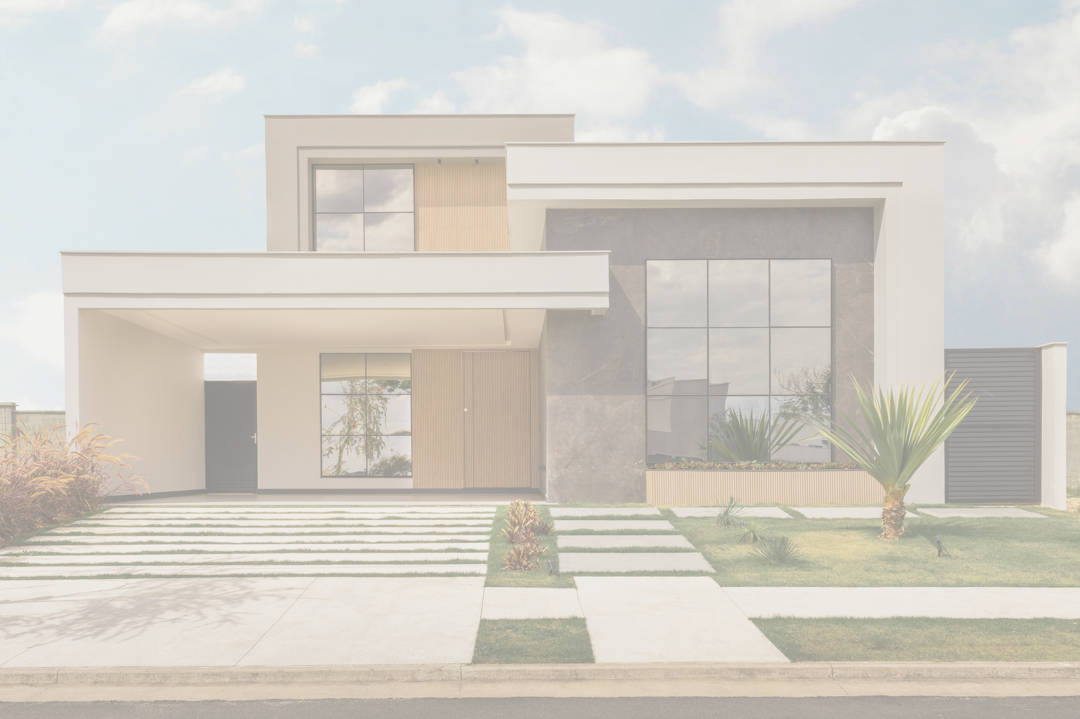

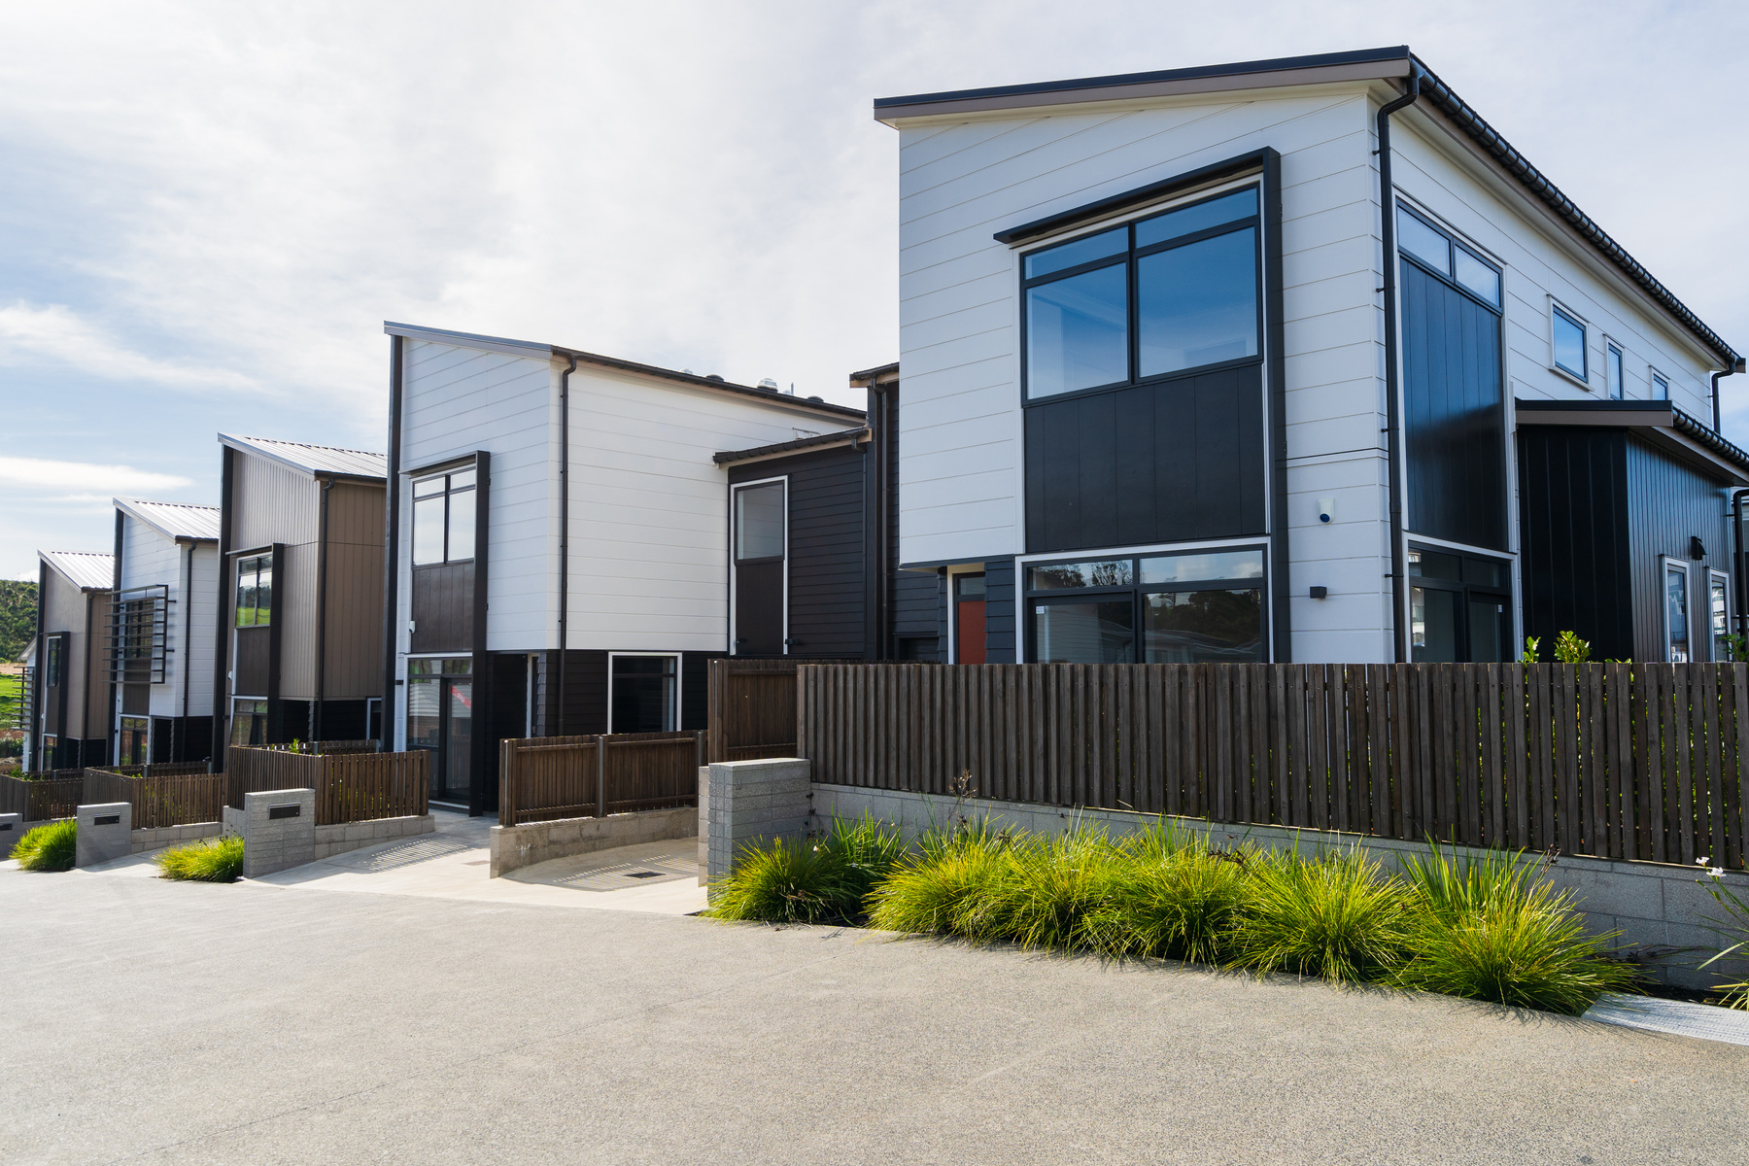
Leading Real-Estate
MARKETING AGENCY
www.scaleacres.com

Slide 2

About Our Company
ScaleAcres is a leading real estate Marketing Firm that specializes in property sales, Lead generation, and strategic growth. With a client-first approach and a deep market understanding, we simplify real estate decisions for individuals and businesses alike.

Slide 3





Our Best Services
WEBSITE DESIGN & DEVELOPMENT
GOOGLE ADS AND META ADS
LEAD GENERATION
Engage with qualified buyers and serious investors through targeted, data-driven marketing strategies that optimize conversions, speed up property sales, and deliver tangible results for real estate success.
Scale Acres offers custom website design and development services tailored to real estate businesses. We build responsive, SEO-optimized, and lead-converting websites that enhance your online presence and drive business growth.
Drive high-quality real estate leads with targeted advertising on Google and Meta. We optimize every campaign for visibility, engagement, and conversions to maximize ROI and accelerate property sales success.

Slide 4





Workflow
OBJECTIVE
STRATEGY
RESULTS
🔹 Identify the client's challenge or goal (e.g., generate quality leads for a real estate project).
Example:
A premium real estate project in Goa struggled to attract qualified leads through traditional methods.
🔹 Explain your approach—campaigns, platforms used, creatives, landing pages, etc.
Example:
Scale Acres launched a targeted Google and Meta ads campaign with custom landing pages
🔹 Share the outcome with numbers (you can use dummy data).
Example:
Within 60 days, over 2,500 quality leads were generated with an average CPL of ₹420.

Slide 5
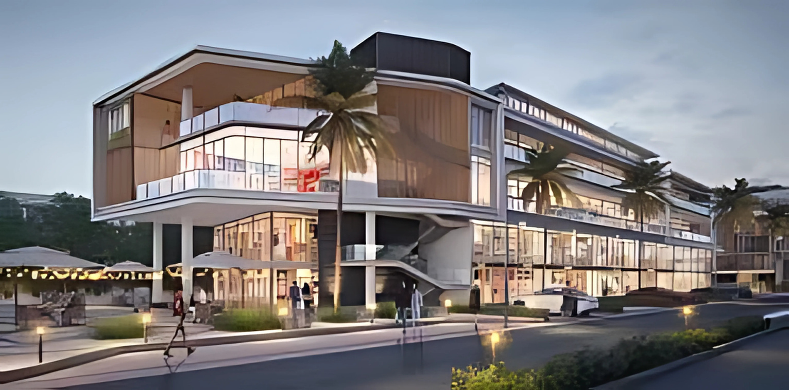
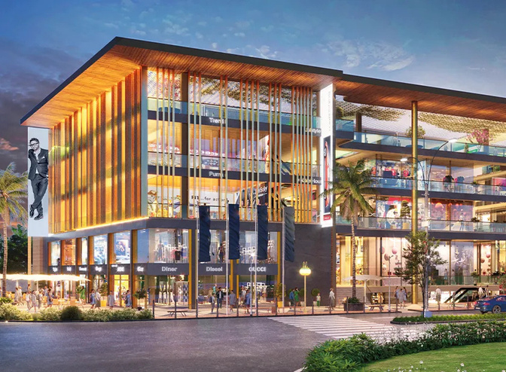

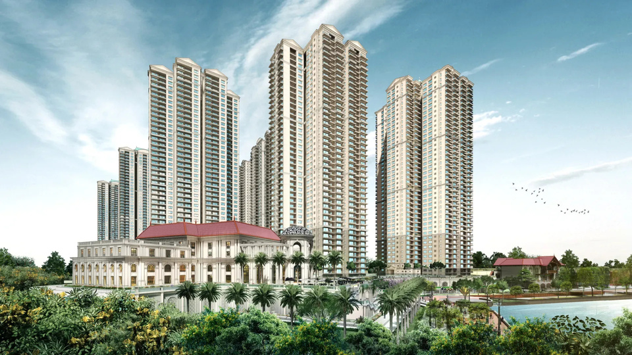
Our Portfolio
We’ve successfully delivered over 15,000+ qualified leads for real estate clients through targeted campaigns across Google, Meta, and landing pages — with an average CPL of ₹350–₹450.
View Our Work:
www.scaleacres.com

Slide 6
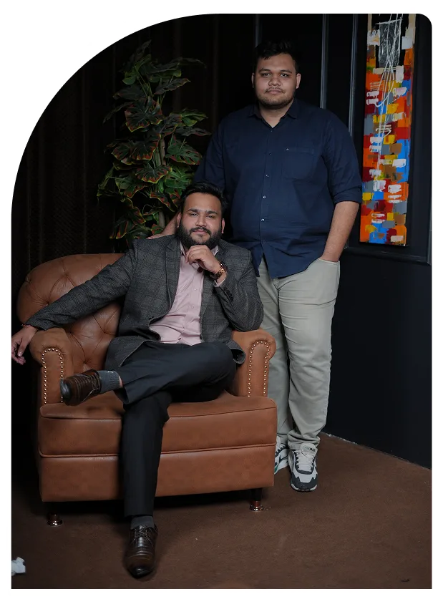
Our Mission
At Scale Acres, our mission is to revolutionize real estate marketing by delivering innovative, data-driven solutions that empower developers, brokers, and channel partners. We aim to enhance brand visibility, generate high-quality leads, and drive measurable growth through tailored digital strategies.
Learn More
2024

Slide 7



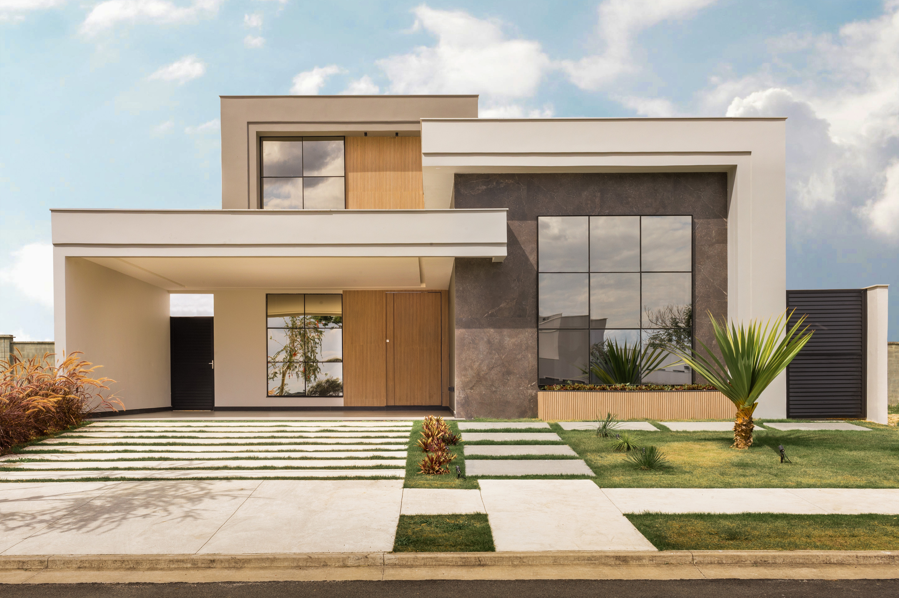

Contact Us
+91 92660 23436
WWW.SCALEACRES.COM
SCALEACRES@GMAIL.COM
PLOT NO 62, 2ND FLOOR SAIDULAJAB WESTEND MARG LANE NO 2, NEW DELHI 110030

Slide 8
THANK YOU

